Slide 1

USER: FITZANDFRO
TECH PACK: 0001
DIMENSIONS
MATERIALS
COMPONENTS
PREVIEW
Dimension Description | Size
Dimension 1
Dimension 2
ADD SIZE
ADD DIMENSION ILLUSTRATION
ADD DIMENSION
Need illustrations? Click here
Not sure what to do? See an example
ADD ANOTHER TABLE

Slide 2
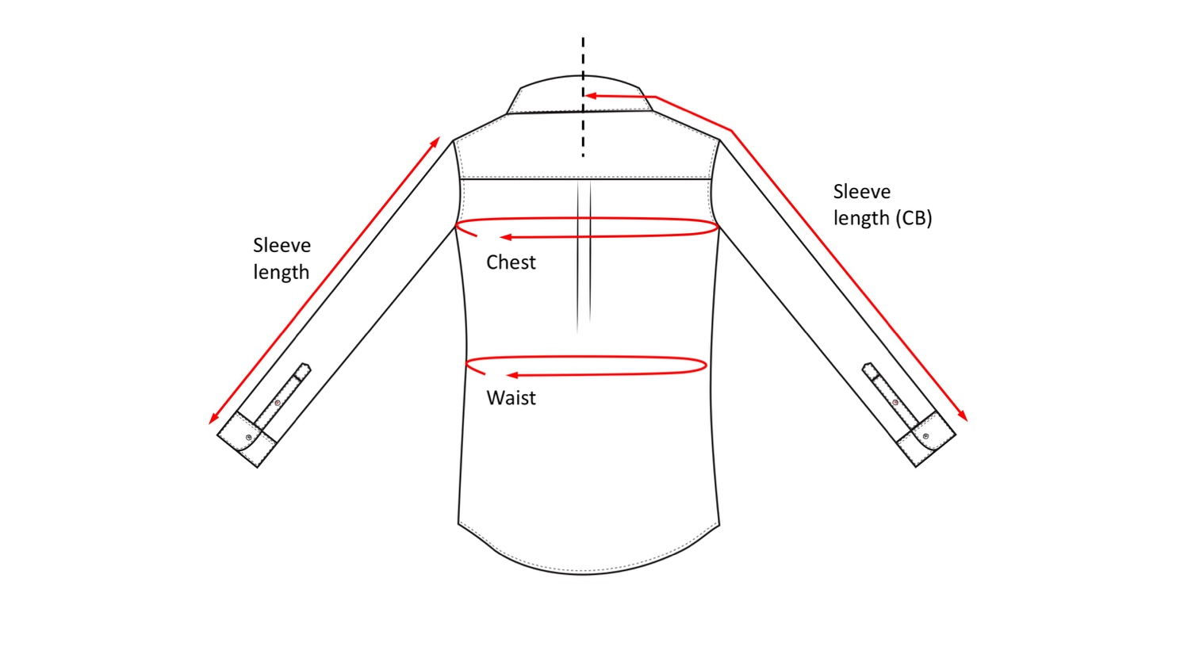
USER: FITZANDFRO
TECH PACK: 0001
DIMENSIONS
MATERIALS
COMPONENTS
PREVIEW
Dimension Description | Small | Medium | Large
Sleeve length
Sleeve length (CB)
Chest circumference
Waist circumference
ADD SIZE
Notes
1
2
1
ADD DIMENSION
Not sure what to do? See an example
2
A
ADD DIMENSION ILLUSTRATION
ADD ANOTHER TABLE
Need illustrations? Click here

Slide 3
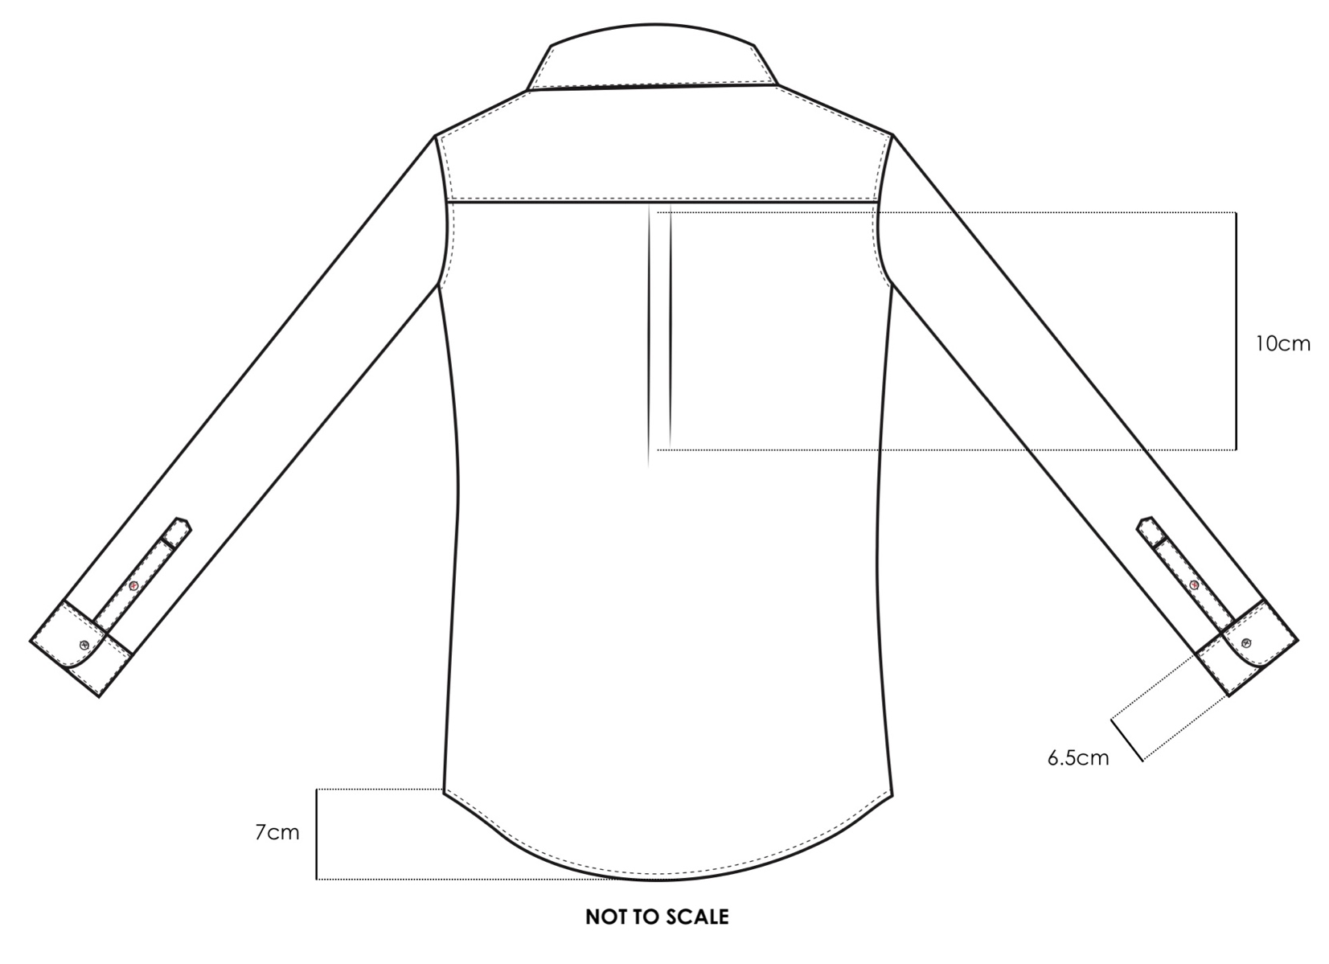
Dimension Description | Small | Medium | Large
Sleeve length
Sleeve length (CB)
Chest circumference
Waist circumference
ADD SIZE
Notes
ADD DIMENSION
Not sure what to do? See an example
Dimension Description | Small | Medium | Large
Pleat length
Cuff length
Hem length
ADD SIZE
Notes
ADD DIMENSION
ADD DIMENSION ILLUSTRATION
ADD ANOTHER TABLE
Need illustrations? Click here

Slide 4
USER: FITZANDFRO
TECH PACK: 0001
DIMENSIONS
MATERIALS
COMPONENTS
PREVIEW
Material Name | Used for
Material 1
Material 2
ADD COLUMN
Notes
ADD IMAGE OF MATERIAL
ADD MATERIAL
Need illustrations? Click here
Not sure what to do? See an example
ADD ANOTHER TABLE

Slide 5
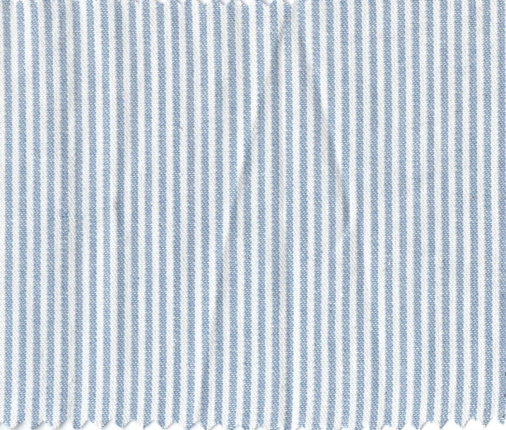
USER: FITZANDFRO
TECH PACK: 0001
DIMENSIONS
MATERIALS
COMPONENTS
PREVIEW
Material Name | Used for
Blue and White striped linen-cotton blend | Style 1 main shirt
Pantone 1485 XGC Thread | Contrast thread colour on sleeve buttons
ADD COLUMN
Notes
A
ADD MATERIAL
Not sure what to do? See an example
A
ADD MATERIAL IMAGE
ADD ANOTHER TABLE
Need illustrations? Click here

Slide 6
USER: FITZANDFRO
TECH PACK: 0001
DIMENSIONS
MATERIALS
COMPONENTS
PREVIEW
Component Name | Details
Component 1
Component 2
ADD COLUMN
Notes
ADD IMAGE OF MATERIAL
ADD MATERIAL
Need illustrations? Click here
Not sure what to do? See an example
ADD ANOTHER TABLE

Slide 7
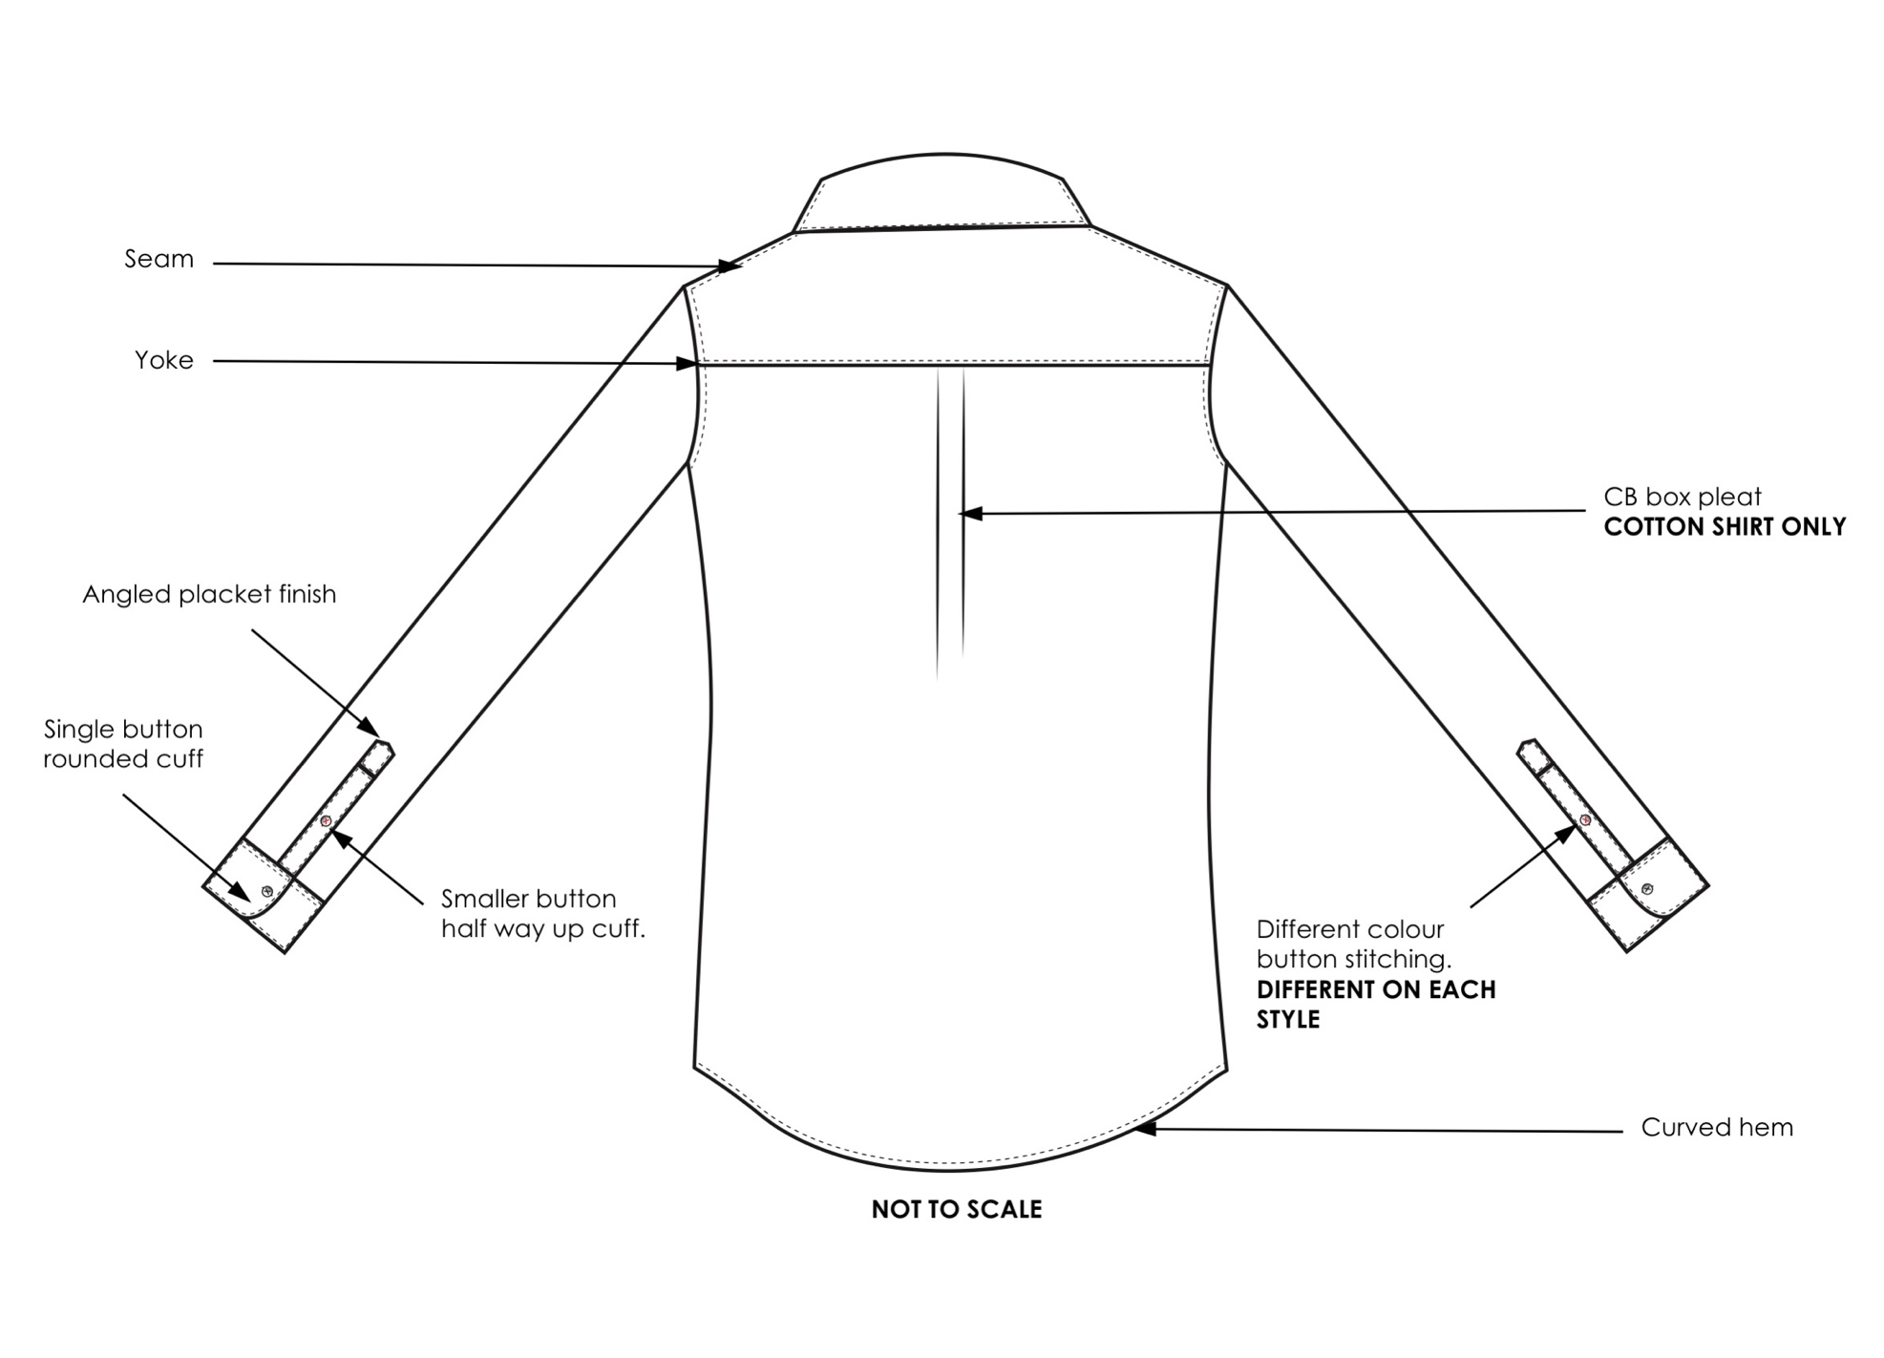
USER: FITZANDFRO
TECH PACK: 0001
DIMENSIONS
MATERIALS
COMPONENTS
PREVIEW
Component Name | Details
Top Seam | Type of seam
Yoke | Straight
Centre Back Box Pleat | Cotton shirt only
Different colour stitching | See Materials for colours
Smaller button half way up cuff | -
Single button rounded cuff | -
Angled placket | 45 degree angle
ADD COLUMN
ADD COMPONENT
Not sure what to do? See an example
ADD ANNOTATED IMAGE
Need illustrations? Click here
ADD ANOTHER TABLE

Slide 8
USER: FITZANDFRO
TECH PACK: 0001
DIMENSIONS
MATERIALS
COMPONENTS
PREVIEW
USER: FITZANDFRO
TECH PACK: 0001
Dimension Description | Small | Medium | Large
Sleeve length
Sleeve length (CB)
Chest circumference
Waist circumference
Dimension Description | Small | Medium | Large
Pleat length
Cuff length
Hem length

Slide 9
Material Name | Used for
Blue and White striped linen-cotton blend | Style 1 main shirt
Pantone 1485 XGC Thread | Contrast thread colour on sleeve buttons
Component Name | Details
Top Seam | Type of seam
Yoke | Straight
Centre Back Box Pleat | Cotton shirt only
Different colour stitching | See Materials for colours
Smaller button half way up cuff | -
Single button rounded cuff | -
Angled placket | 45 degree angle

